Slide 1
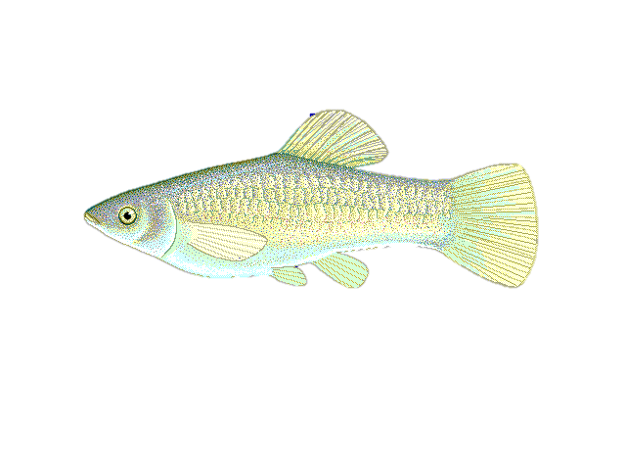
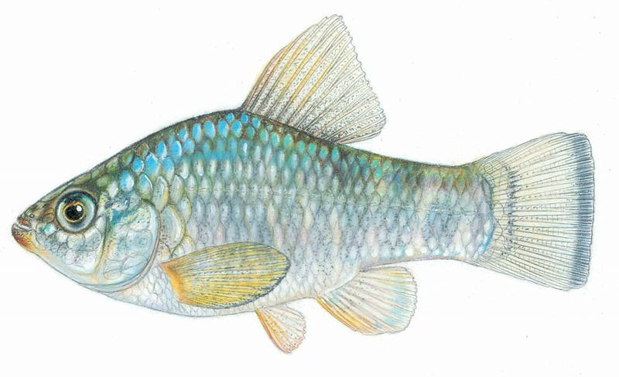
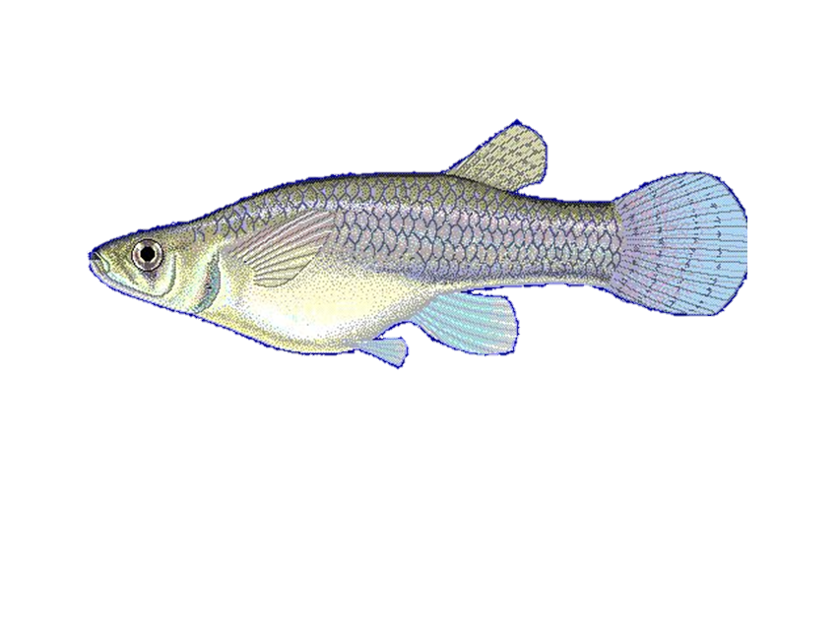
Poecilia Formosa
No copyright. Public Domain
Cyrpinodon variegatus
Credit: Joseph R. Tomelleri
Gambusia affinis
Credit: Robbie N. Cada

Slide 2
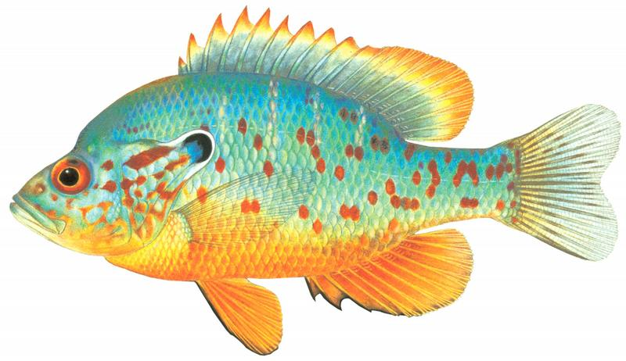
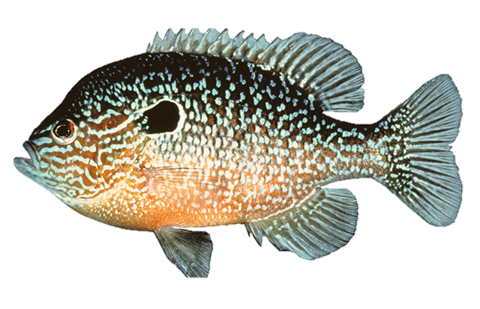
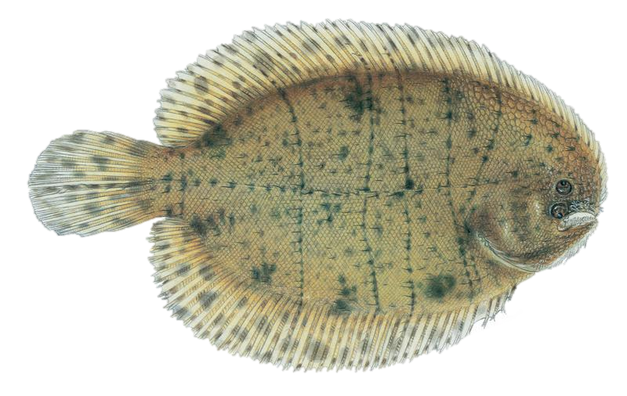
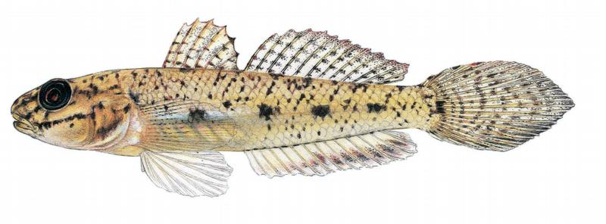
Lepomis humilis
Credit: Joseph R. Tomelleri
Trinectes maculatus
Credit: Joseph R. Tomelleri
Lepomis megalotis
Credit: Noel Burkhead
Ctenogobius shufeldti
Credit: Joseph R. Tomelleri

Slide 3
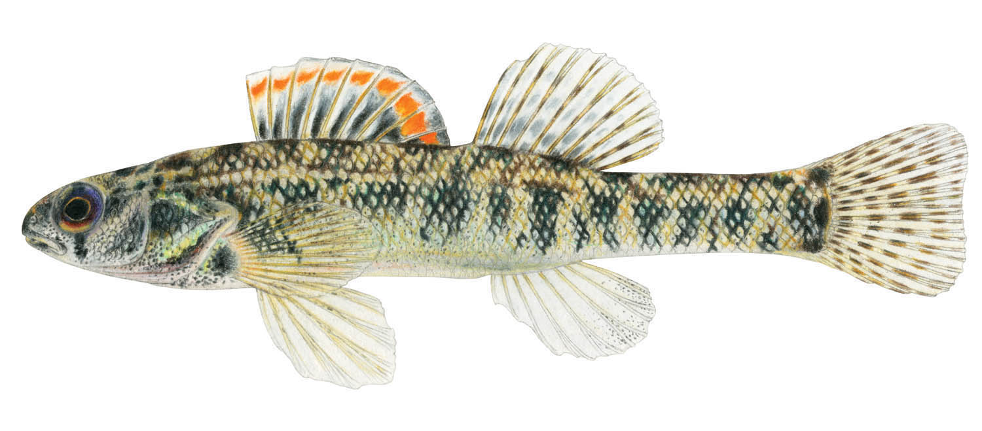
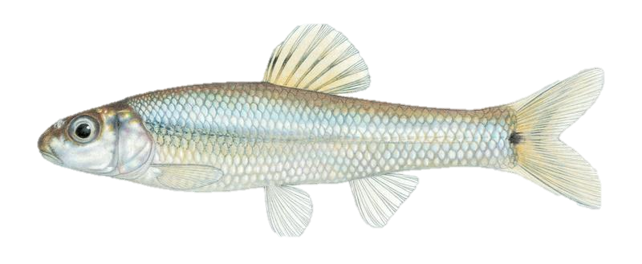
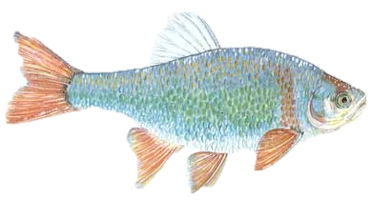
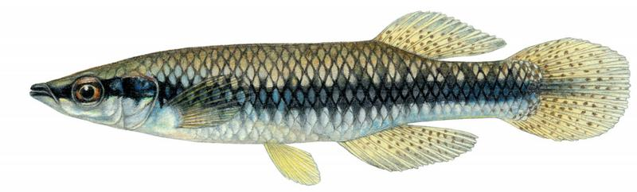
Etheostoma gracile
Credit: TNACI FIN
Pimephales vigilax
Credit: Fishes of Texas
Cyrpinella lutrensis
Credit: TPWD
Fundulus notatus
Credit: Joseph R. Tomelleri

Slide 4
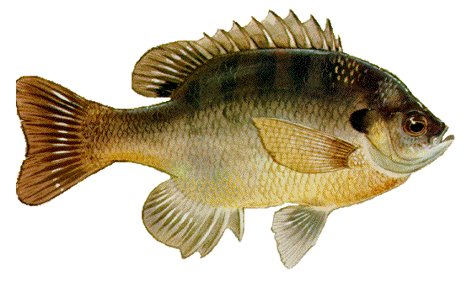
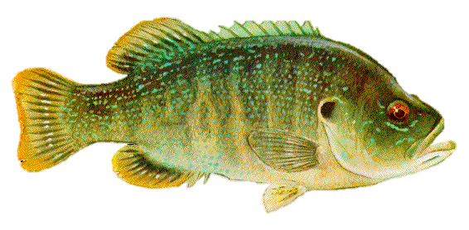
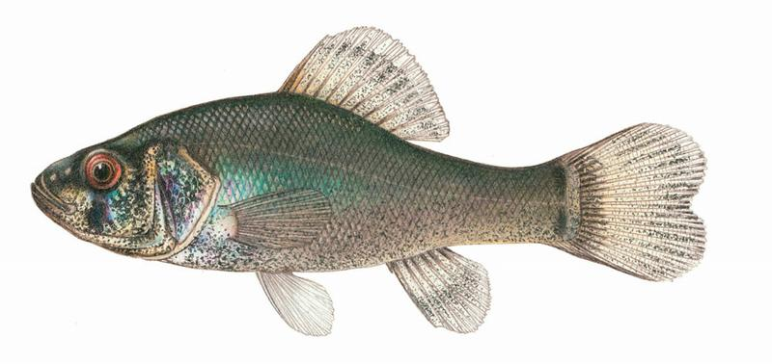
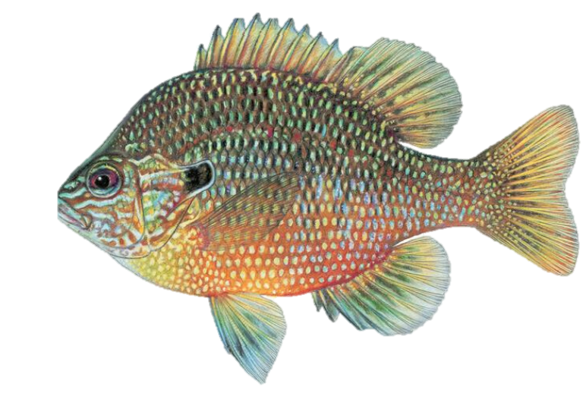
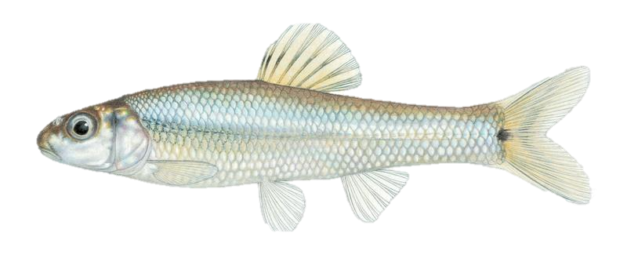
Lepomis macrochirus
Credit: TPWD
Lepomis cyanellus
Credit: TPWD
Aphredoderus sayanus
Credit: Joseph R. Tomelleri
Lepomis marginatus
Credit: TPWD
Pimephales vigilax
Credit: Joseph R. Tomelleri

Slide 5
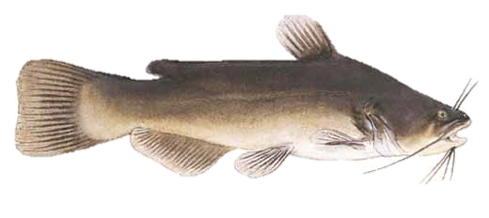
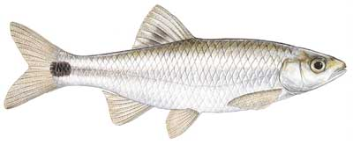
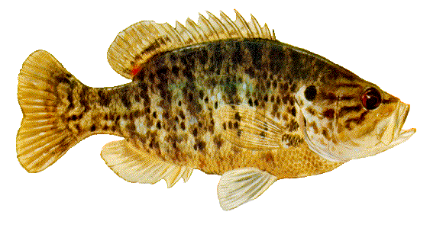
Ameiurus melas
Credit: TPWD
Cyprinella venusta
Credit: TPWD
Lepomis gulosus
Credit: TPWD

Slide 6
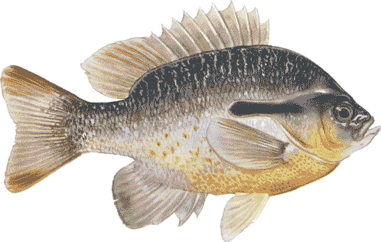
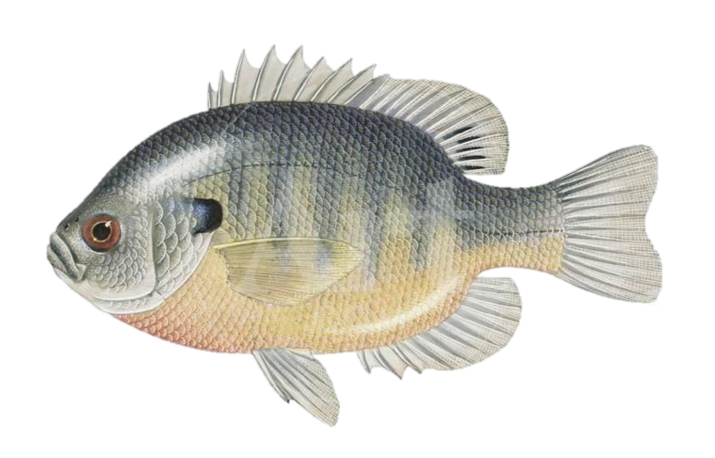
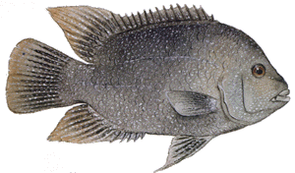
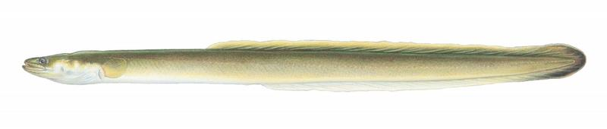
Lepomis auritus
Credit: TPWD
Lepomis macrochirus
Credit: Encyclopedia Britannica
Herichthys cyanoguttatus
Credit: TPWD
Anguilla rostrata
Credit: Joseph Tomelleri

